Slide 1
Oracle 11g: SQL
Chapter 5
Data Manipulation and Transaction Control

Slide 2
Objectives
Use the INSERT command to add rows to a table
Manage virtual columns in data manipulations
Use quotes in data values
Use a subquery to copy records from an existing table
Use the UPDATE command to modify the existing rows of a table
Use substitution variables with an UPDATE command

Slide 3
INSERT Command
Used to add rows to existing tables
Can only add one row at a time to one table
Identify the table in the INSERT INTO clause
Specify data in the VALUES clause
  Enclose nonnumeric data in single quotes
  If a column list is not provided, a value must be assigned to each column in the table in order
Oracle 11g: SQL

Slide 4
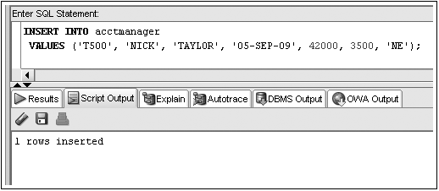
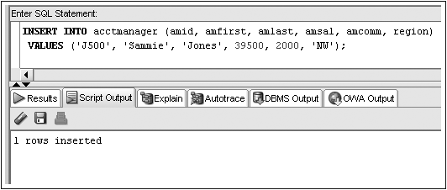
INSERT Command Examples
No Column List
Column List

Slide 5
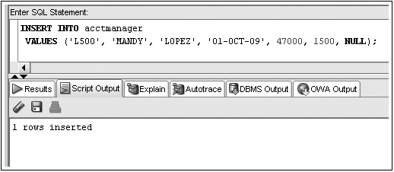
Inserting NULL Value
Omit column name from INSERT INTO clause column list
Substitute two single quotation marks or use NULL keyword
NULL value input

Slide 6
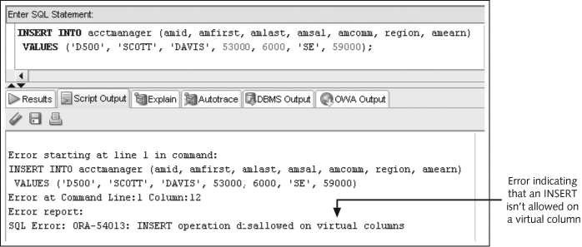
Manage Virtual Column Input

Slide 7
Constraint Violations
When you add or modify table data, the data is checked for compliance with any applicable constraints

Slide 8
Activating the DEFAULT option
Include a column list in the INSERT statement without the column to use the DEFAULT option
Use the DEFAULT keyword as the value for the column

Slide 9
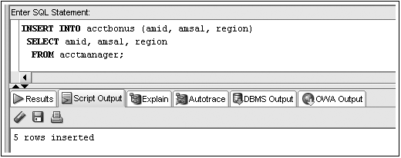
Inserting Data from an Existing Table
Substitute subquery for VALUES clause
Subquery

Slide 10
Modifying Existing Rows
Use UPDATE command to:
  Add values to an existing row by replacing NULL values
  Change existing values

Slide 11

UPDATE Command
UPDATE clause identifies table
SET clause identifies column(s) being changed and the new value(s)
Optional WHERE clause specifies which row(s) to be changed
Notes:
– if WHERE omitted, all rows will be updated!

Slide 12
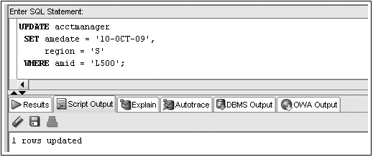
UPDATE Command Example

Slide 13
Substitution Variables
Prompts user for value
Identified by ampersand (&) preceding variable name
Can be used to create interactive scripts

Slide 14
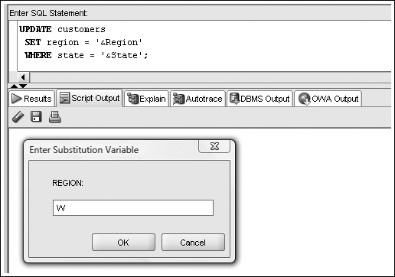
Substitution Variable Example

Slide 15
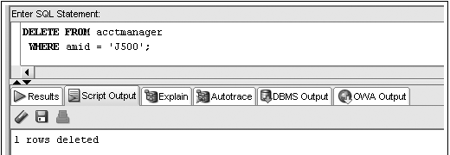
Deleting Rows
DELETE command removes rows from a table
WHERE clause determines which row(s) are removed
Omitting WHERE clause removes all rows

Slide 16
Transaction Control Statements
Results of data manipulation language (DML) are not permanently updated to a table until explicit or implicit COMMIT occurs
Transaction control statements can:
  Commit data through COMMIT command
  Undo data changes by ROLLBACK command

Slide 17
COMMIT Command
Explicit COMMIT occurs by executing COMMIT;
Implicit COMMIT occurs when DDL command is executed or user properly exits system
Permanently updates table(s) and allows other users to view changes

Slide 18
ROLLBACK Command
Used to “undo” changes that have not been committed
Occurs when:
  ROLLBACK; is executed
  System restarts after a crash
SAVEPOINT marks a specific spot within the transaction
Can ROLLBACK to a SAVEPOINT to undo part of the transaction

Slide 19
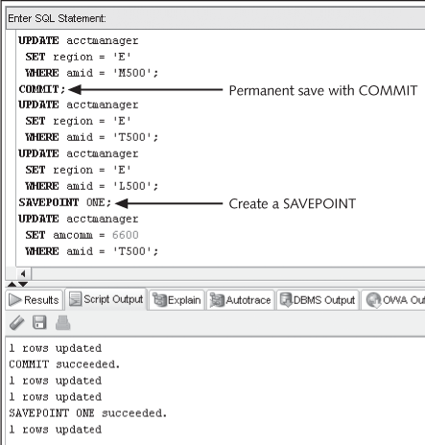
Transaction Control Example

Slide 20
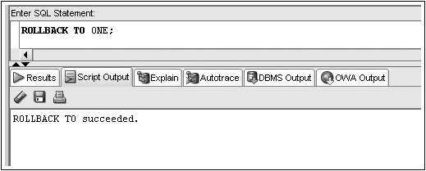
Transaction Control Example (continued)

Slide 21
Table Locks
Prevent users from changing same data or objects at the same time
Shared
  prevents DML operations on a portion of table
Exclusive
  locks whole table preventing other exclusive or shared locks

Slide 22
LOCK TABLE Command Shared Lock
Locks portion of table affected by DML operation
Implicitly occurs during UPDATE or DELETE operations
Explicitly occurs through LOCK TABLE command with SHARE MODE option
Released when COMMIT (implicit or explicit) or ROLLBACK occurs

Slide 23
LOCK TABLE Command Exclusive Lock
Implicitly locks table for DDL operations
– CREATE or ALTER TABLE
Explicitly locked through LOCK TABLE command with EXCLUSIVE MODE option
Released after execution of DDL operation or after user exits system

Slide 24
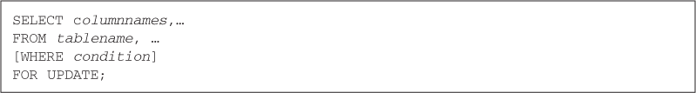
SELECT…FOR UPDATE Command
Creates shared lock on retrieved portion of table
Prevents one user from changing a row while another user is selecting rows to be changed
Released through implicit or explicit commit

